Slide 1

Day Care Project
Team 3

Slide 2
Group Members
Yifan Chen: Program Design, Function Implementation
Chao Yan: Program Design, Dataset Preparation, GUI
Feng Xiong: Program Design, Try-Catch, Slides

Slide 3
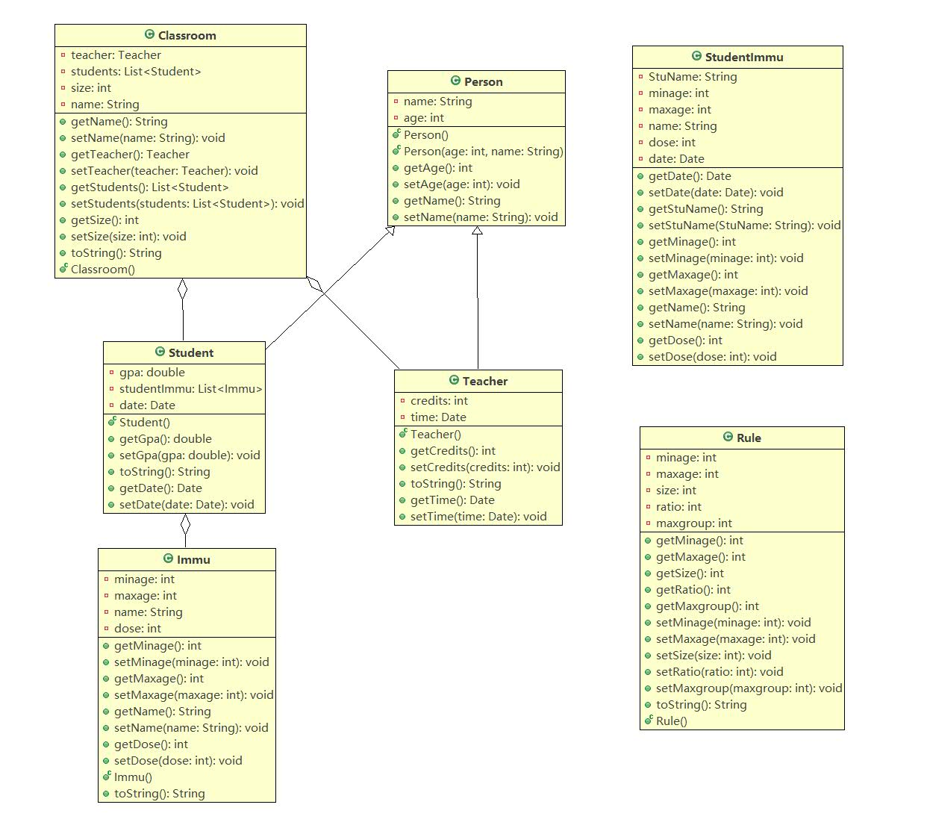
UML Diagram

Slide 4
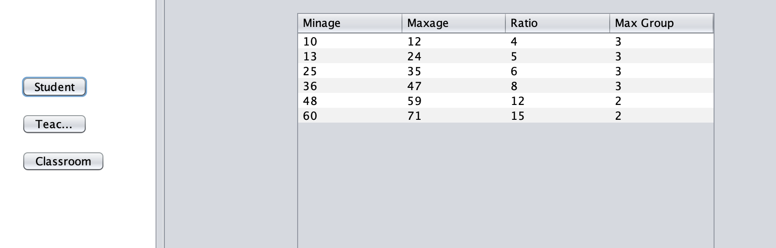
Operation Instructions
When first open up the program, Student Teacher Ratio Rules will first displayed.

Slide 5
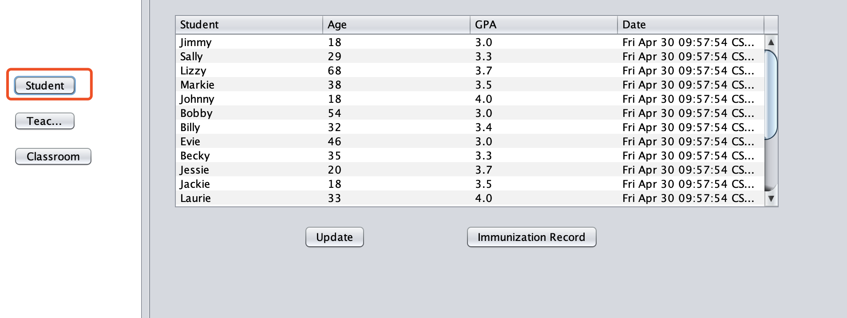
Operation Instructions
When click on Student button, it will display enrolled student information.

Slide 6
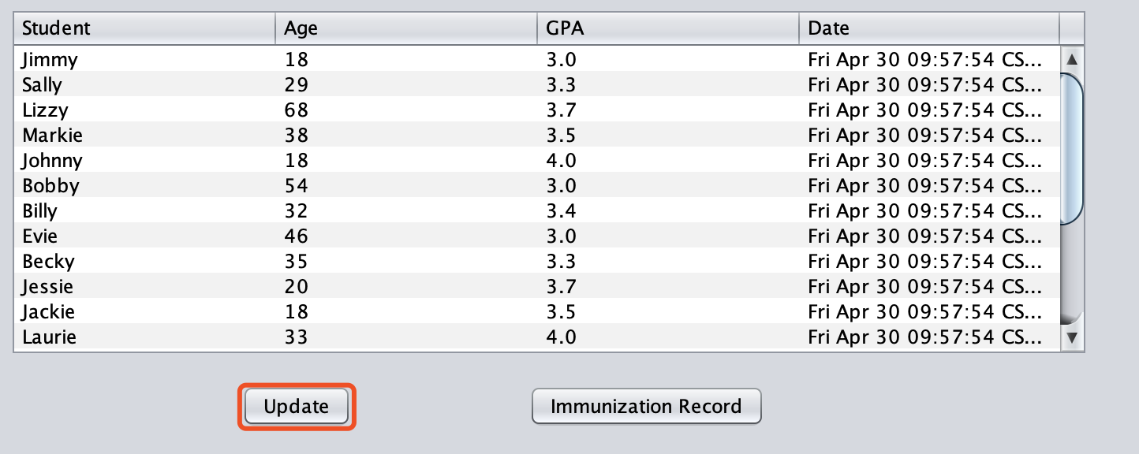
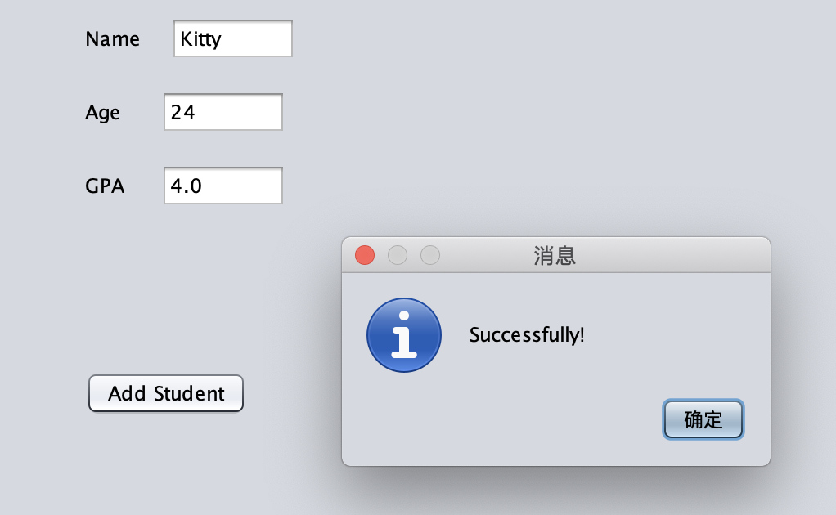
Operation Instructions
Click on Update button to enroll new student

Slide 7
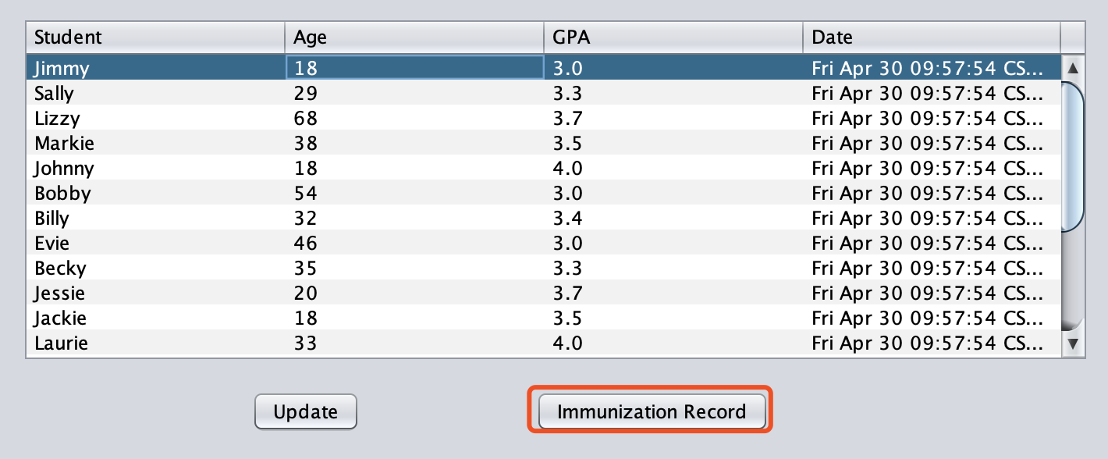
Operation Instructions
1. Select one student first
2. Click Immunization Record button to see his or her Immunization Record

Slide 8
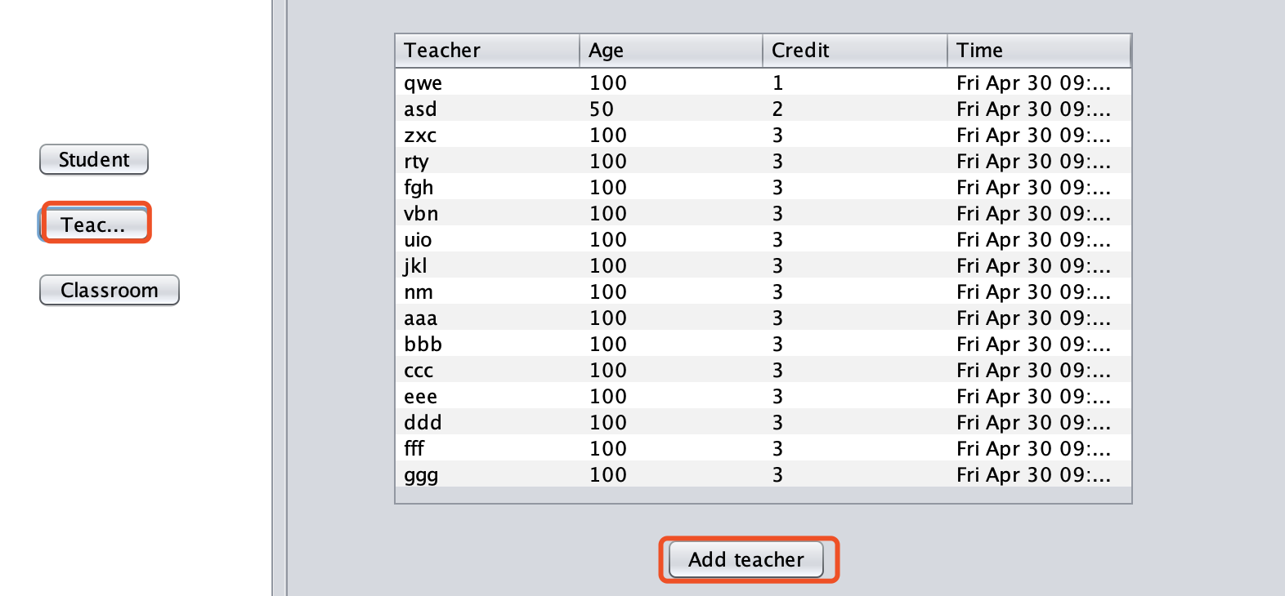
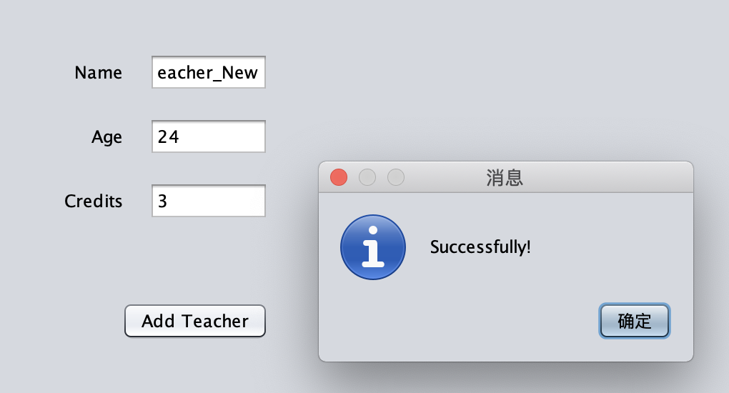
Operation Instructions
1. Similarly, Teacher menu returns all teachers’ information
2. Add teacher by entering Teacher’s Name, Age and Credits

Slide 9
Operation Instructions
Classroom
在这几页插入一下GUI的截图 然后说明每个Button的作用和Demo吧

Slide 10
Operation Instructions
Classroom
在这几页插入一下GUI的截图 然后说明每个Button的作用和Demo吧

Slide 11
Difficulties Encountered and Solutions

Slide 12
Further Improvements

